Slide 1
Sorting Algorithms
PEMP-CSN2501
Data Structures & Algorithms
HND CSD
BCAS Campus, Kalmunai

Slide 2
Textbook
C & Data Structures
P. S. Deshpande, O. G. Kakde
CHARLES RIVER MEDIA, INC. Hingham, Massachusetts

Slide 3
What is Algorithm?
Algorithm:
A computable set of steps to achieve a desired result
Relationship to Data Structure
Example: Find an element
2
4
6
1
3
5
7
1
2
3
4
5
6
7

Slide 4
Sorting Algorithms
PEMP CSN2501
A sorting algorithm is an algorithm that puts elements of a list in a certain order
The most used orders are numerical order
Efficient sorting is important to optimize the use of other algorithms that require sorted lists to work correctly
N D Gangadhar MSRSAS
©M.S.Ramaiah School of Advanced Studies - Bangalore

Slide 5


SORTING ALGORITHMS

Slide 6
SORTING ALGORITHMS
We need to do sorting for the following reasons :
a) By keeping a data file sorted, we can do binary search on it.
b) Doing certain operations, like matching data in two different files, become much faster.
There are various methods for sorting: Bubble sort, Insertion sort, Selection sort, Quick sort, Heap sort, Merge sort…. They have different average and worst case behaviors:

Slide 7
List of Various Sorting Algorithms
PEMP CSN2501
Bubble Sort Selection Sort Insertion Sort Merge Sort Quick Sort Heap Sort
N D Gangadhar MSRSAS
©M.S.Ramaiah School of Advanced Studies - Bangalore

Slide 8
1. BUBBLE SORT
Introduction:
Bubble sorting is a simple sorting technique in which we arrange the elements of the list by forming pairs of adjacent elements. That means we form the pair of the ith and (i+1)th element. If the order is ascending, we interchange the elements of the pair if the first element of the pair is greater than the second element.

Slide 9
1. Bubble Sort
PEMP CSN2501
It is also known as exchange sort.
It is a simple sorting algorithm. It works by repeatedly stepping through the list to be sorted, comparing two items at a time and swapping them if they are in the wrong order.
The pass through the list is repeated until no swaps are needed, which means the list is sorted.
The algorithm gets its name from the way smaller elements "bubble" to the top (i.e., the beginning) of the list via the swaps.
Because it only uses comparisons to operate on elements, it is a comparison sort. This is the easiest comparison sort to implement.
N D Gangadhar MSRSAS
©M.S.Ramaiah School of Advanced Studies - Bangalore

Slide 10
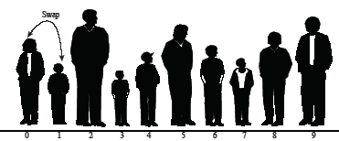

1. BUBBLE SORT
Bubble sort: beginning of first pass

Slide 11


1. BUBBLE SORT

Slide 12

1. BUBBLE SORT
Bubble sort: end of First pass

Slide 13
Trace of a Bubble Sort
PEMP CSN2501
I Pass
A[0] = 40
A[1] = 50
A[2] = 30
A[3] = 20
A[4] = 10
40
50
30
20
10
40
30
50
20
10
40
30
20
50
10
N D Gangadhar MSRSAS
©M.S.Ramaiah School of Advanced Studies - Bangalore

Slide 14
contd…Trace of a Bubble Sort
PEMP CSN2501
II Pass
III Pass
IV Pass
Sorted Array
40 30
30 40
20 20
10 10
50 50
30
20
40
10
50
30 20
20 30
10 10
40 40
50 50
20
10
30
40
50
10
20
30
40
50
N D Gangadhar MSRSAS
©M.S.Ramaiah School of Advanced Studies - Bangalore

Slide 15
2. Selection Sort
PEMP CSN2501
Selection sort is a sorting algorithm, specifically an in- place comparison sort.
Selection sort is noted for its simplicity, and also has performance advantages over more complicated algorithms in certain situations.
It works as follows:
Find the minimum value in the list
Swap it with the value in the first position
Repeat the steps above for remainder of the list (starting at the second position)
N D Gangadhar MSRSAS
©M.S.Ramaiah School of Advanced Studies - Bangalore

Slide 16
Trace of a Selection Sort
PEMP CSN2501
I
05
20
40
45
15
25
50
35
30
10
II
05
10
40
45
15
25
50
35
30
20
III
05
10
15
45
40
25
50
35
30
20
IV
05
10
15
20
40
25
50
35
30
45
V
05
10
15
20
25
40
50
35
30
45
VI
05
10
15
20
25
30
Passes ◊
A[0] = 45
A[1] = 20
A[2] = 40
A[3] = 05
A[4] = 15
A[5] = 25
A[6] = 50
A[7] = 35
A[8] = 30
A[9] = 10
50
35
40
45
N D Gangadhar MSRSAS
©M.S.Ramaiah School of Advanced Studies - Bangalore

Slide 17
contd….Trace of a Selection Sort
PEMP CSN2501
VII
05
10
15
20
25
30
35
50
40
45
VIII
05
10
15
20
25
30
35
40
50
45
IX
05
10
15
20
25
30
35
40
45
50
Sorted Array
05
10
15
20
25
30
35
40
45
50
N D Gangadhar MSRSAS
©M.S.Ramaiah School of Advanced Studies - Bangalore

Slide 18

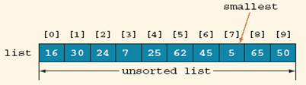
Example For Selection Sort

Slide 19
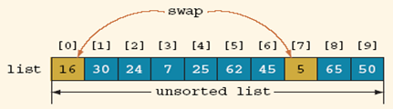
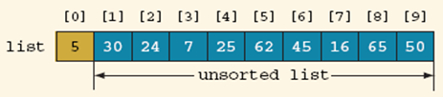
Example For Selection Sort

Slide 20
3.Insertion Sort
PEMP CSN2501
Insertion sort is a simple sorting algorithm, a comparison sort in which the sorted array (or list) is built one entry at a time.
Simple to implement. Efficient on small data sets.
Efficient on data sets which are already substantially sorted Runs in O(n + d) time, where d is the number of inversions
Stable (does not change the relative order of elements with equal keys) In-place (only requires a constant amount O(1) of extra memory space) It is an online algorithm, in that it can sort a list as it receives it.
N D Gangadhar MSRSAS
©M.S.Ramaiah School of Advanced Studies - Bangalore

Slide 21
3. INSERTION SORT
Introduction:
Basic Idea: Insert a record R into a sequence of ordered records: R1,R2,.., Ri with keys K1 <= K2 <= ... <= Ki , such that, the resulting sequence of size i+1 is also ordered with respect to key values.

Slide 22
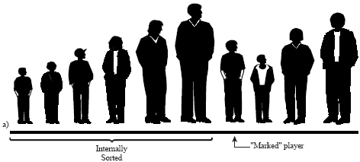
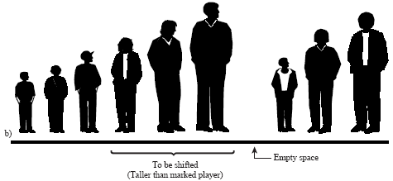
3. INSERTION SORT

Slide 23
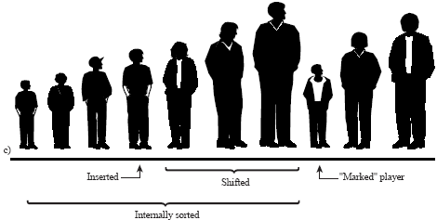
3. INSERTION SORT

Slide 24
Trace: Insertion Sort
PEMP CSN2501
a[0] = 20
a[1] = 10
a[2] = 30
a[3] = 15
a[4] = 25
a[5] = 05
10
20
30
15
25
05
10
15
20
30
25
05
10
15
20
25
30
05
05
10
15
20
25
30
10
20
30
15
No
change
25
05
N D Gangadhar MSRSAS
©M.S.Ramaiah School of Advanced Studies - Bangalore

Slide 25
4. Merge Sort
PEMP CSN2501
Merge sort is a O(n log n) sorting algorithm
It is easy to implement merge sort such that it is stable, meaning it preserves the input order of equal elements in the sorted output
It is an example of the divide and conquer algorithmic paradigm and are usually recursive in nature
It is a comparison sort
Space complexity is the main problem
N D Gangadhar MSRSAS
©M.S.Ramaiah School of Advanced Studies - Bangalore

Slide 26
Merge Sort: Algorithm
PEMP CSN2501
Divide the array into two equal parts. Recursively sort the left part of the array Recursively sort the right part of the array
Merge the sorted left and the right part into a single sorted vector using the concept of Simple Merge.
N D Gangadhar MSRSAS
©M.S.Ramaiah School of Advanced Studies - Bangalore

Slide 27
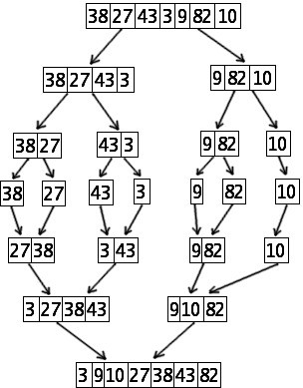
Trace of a Merge Sort
PEMP CSN2501
N D Gangadhar MSRSAS
©M.S.Ramaiah School of Advanced Studies - Bangalore

Slide 28
5. Quick Sort
PEMP CSN2501
Quick sort is a well-known sorting algorithm It is also called as Partition Exchange Sort
On an average, makes O(n log n) comparisons to sort n items However, in the worst case, it makes O(n²) comparisons
Typically, quick sort is significantly faster in practice than other O(n log n) algorithms
because its inner loop can be efficiently implemented on most architectures, and
in most real-world data it is possible to make design choices which minimize the possibility of requiring time
Quick sort is a comparison sort and, in efficient implementations, is not a stable sort.
N D Gangadhar MSRSAS
©M.S.Ramaiah School of Advanced Studies - Bangalore

Slide 29
Trace of a Quick Sort
PEMP CSN2501
low
i
high, j
42 | 37 | 11 | 98 | 36 | 72 | 65 | 10 | 88 | 78
42>37 so, i++
i
42 | 37 | 11 | 98 | 36 | 72 | 65 | 10 | 88 | 78
42>11 so, i++
i
42 | 37 | 11 | 98 | 36 | 72 | 65 | 10 | 88 | 78
42>98 stop, i++, & compare 42 with a[j] = 78
42<78 so, j--
i
42 | 37 | 11 | 98 | 36 | 72 | 65 | 10 | 88 | 78
N D Gangadhar MSRSAS
©M.S.Ramaiah School of Advanced Studies - Bangalore

Slide 30
Trace of a Quick Sort
PEMP CSN2501
i
j
42 | 37 | 11 | 98 | 36 | 72 | 65 | 10 | 88 | 78
42<88 so, j--
i
42 | 37 | 11 | 98 | 36 | 72 | 65 | 10 | 88 | 78
42<10 stop, j--
Since i<j, exchange a[i] with a[j] and repeat the process
i j
42>10 so, i++
i
42>36 so, i++
42 | 37 | 11 | 10 | 36 | 72 | 65 | 98 | 88 | 78
N D Gangadhar MSRSAS
42 | 37 | 11 | 10 | 36 | 72 | 65 | 98 | 88 | 78
©M.S.Ramaiah School of Advanced Studies - Bangalore

Slide 31
Trace of a Quick Sort
i j
PEMP CSN2501
42 | 37 | 11 | 10 | 36 | 72 | 65 | 98 | 88 | 78
42>36 so, i++
i
j
42 | 37 | 11 | 10 | 36 | 72 | 65 | 98 | 88 | 78
42>72 stop, i++, & compare 42 with a[j] = 98
i
j
42 | 37 | 11 | 10 | 36 | 72 | 65 | 98 | 88 | 78
42<98 so, j--
i
j
42 | 37 | 11 | 10 | 36 | 72 | 65 | 98 | 88 | 78
42<65 so, j--
N D Gangadhar MSRSAS
©M.S.Ramaiah School of Advanced Studies - Bangalore

Slide 32
Trace of a Quick Sort
i,j
PEMP CSN2501
42 | 37 | 11 | 10 | 36 | 72 | 65 | 98 | 88 | 78
42<72 so, j--
j
i
42 | 37 | 11 | 10 | 36 | 72 | 65 | 98 | 88 | 78
42<36 FALSE
Since i exceeds j, exchange a[low] with a[j].
j i
low
42 | 37 | 11 | 10 | 36 | 72 | 65 | 98 | 88 | 78
N D Gangadhar MSRSAS
©M.S.Ramaiah School of Advanced Studies - Bangalore

Slide 33
Trace of a Quick Sort
PEMP CSN2501
The sorted array after partition
36 | 37 | 11 | 10 | 42 | 72 | 65 | 98 | 88 | 78
<42
>42
Pivot Element
N D Gangadhar MSRSAS
©M.S.Ramaiah School of Advanced Studies - Bangalore

Slide 34
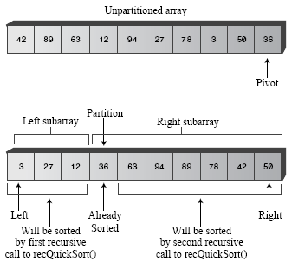
Example for Quick Sort

Slide 35
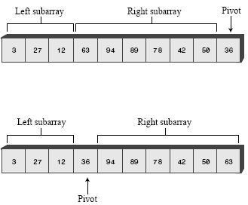
Example for Quick Sort

Slide 36
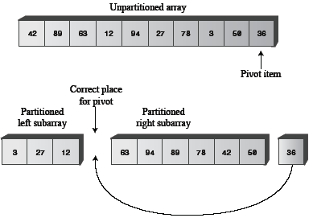
Example for Quick Sort

Slide 37
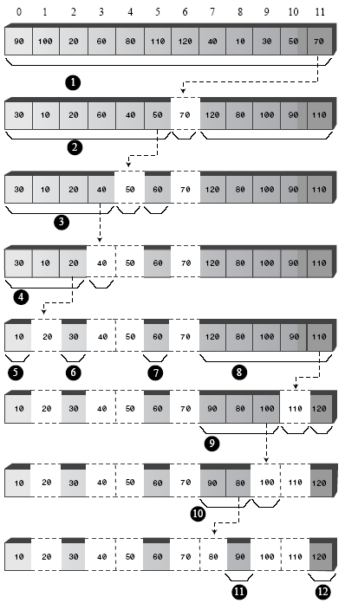
4. QUICK SORT

Slide 38
6. Heap Sort
Merge sort time is O(n log n)
But requires (temporarily) n extra storage items
Heapsort
Works in place: no additional storage
Offers same O(n log n) performance
Idea (not quite in-place):
Insert each element into a priority queue
Repeatedly remove from priority queue to array
Array slots go from 0 to n-1

Slide 39
Algorithm for In-Place Heapsort
Build heap starting from unsorted array
While the heap is not empty
Remove the first item from the heap:
Swap it with the last item
Restore the heap property

Slide 40
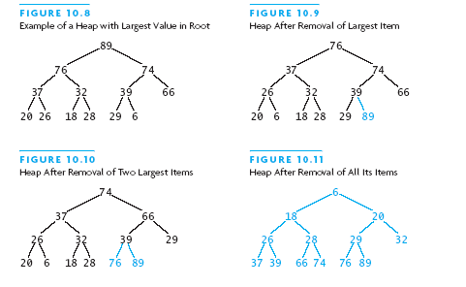

Slide 41
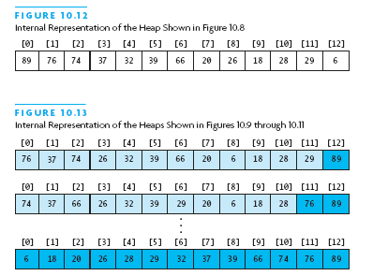

Slide 42
THANK YOU!
BY: Eng. A.L. Jubailah Begum

